Slide 1
Understanding and Exploiting the Tumor Microenvironment in Glioblastoma
Maria Gubbiotti, MD/PhD Candidate
Jefferson Medical College

Slide 2
The burden of brain cancer
<1% chance of developing malignant brain cancer during one’s lifetime
In 2019:
~23,820 malignant tumors of the brain and spinal cord will be diagnosed
~17,760 people will die from these tumors
Despite extensive research and funding, there are still no great therapeutic options for these patients

Slide 3
Overview of Brain Tumors
Benign
Certain types of meningiomas
Schwannomas
Despite their “benign” nature, these tumors can still cause issues by destroying normal parenchyma
Malignant
Gliomas
Astrocytomas
Oligodendrogliomas
Ependymomas
Medulloblastomas
Gangliogliomas

Slide 4
Grading of Brain Tumors
WHO has an extensive description for each tumor subtype
Constantly evolving
Grades I-IV
I: slow-growing and non-invasive
IV: fast-growing, require aggressive treatment

Slide 5
Glioblastoma Multiforme (GBM)
Most aggressive form of brain cancer
Can originate from normal brain cells or develop from existing low-grade glioma
Signs/symptoms include: headache, changes in mental status/behavior/focal neurological signs, nausea

Slide 6
Anaplastic Cells

Slide 7
Microvascular Proliferation

Slide 8
Palisading Necrosis

Slide 9
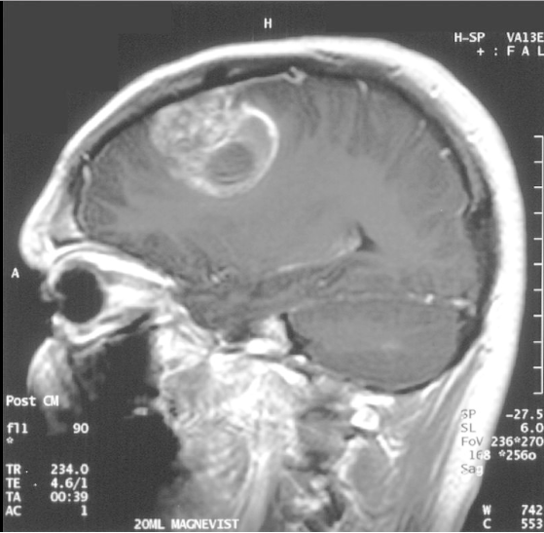
Diagnosis/Prognosis
Suspicion based on clinical presentation
Ring-enhancing lesion on MRI
Notes:
Nonspecific…abscesses etc

Slide 10
Diagnosis/Prognosis
Histological confirmation via pathology
Biopsy and have intra-op frozen section
Prognosis depends on molecular subtype although it is overwhelmingly poor compared to other cancers

Slide 11
Molecular Subtypes (not exhaustive)
IDH (wild-type or R32H mutant)
BRAF
EGFR
MGMT

Slide 12
IDH-related GBM
Isocitrate dehydrogenase
Gene located on chromosome 2, enzyme catalyzes conversion of isocitrate to α-ketoglutarate in the Krebs cycle
Wild-type
Most GBM are of this type (90%)
Typically found in patients >55 yrs
Mutant: R132H
Found in only 10% of GBM cases, typically in younger patients, also related to secondary glioblastoma as some of these patients have history of prior glioma
Mutation in the active site of the enzyme resulting in loss of function and increase in an alternate product 2-hydroxyglutarate
2-hydroxyglutarate tends to inhibit histone and DNA demethylases resulting in changes in genetic signatures leading to increased tumorigenesis
Also renders cells more susceptible to oxidative stress due to lower production of NADPH
Better prognosis than wild-type
Notes:
Mutant better prognosis

Slide 13
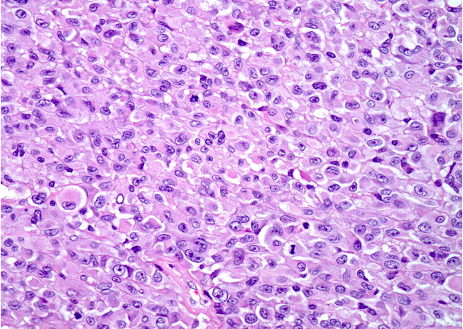
BRAF: Epithelioid GBM
IDH-wildtype GBM
Large cells, abundant cytoplasm, some rhabdoid cells
Typically seen in children and younger adults
Harbor the classical V600E mutation

Slide 14
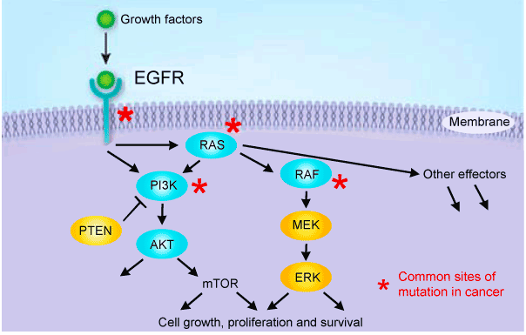
EGFR
Epidermal growth factor receptor
Amplification of the gene
Constitutive activity of the kinase

Slide 15
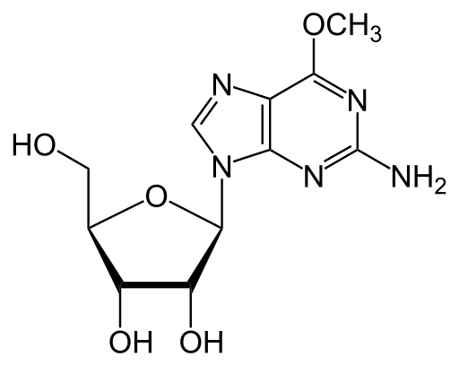
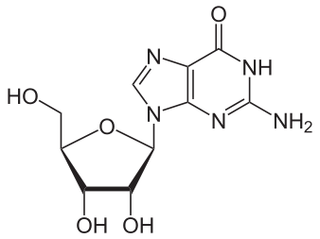
MGMT
O-6-methylguanine-DNA methyltransferase
Provides cells with defense mechanism against alkylating agent chemotherapy
MGMT

Slide 16
MGMT promoter region
The promoter of the MGMT gene contains a CpG island that is 777 bp long and contains 97 CpG dinucleotides.
Two distinct regions (differentially methylated regions 1 and 2 (DMR1 and DMR2) had the greatest impact in mRNA expression.

Slide 17
Current Treatment
Resection, radiation, chemotherapy
Temozolomide is the agent of choice
Alkylating agent that damages DNA
MGMT methylation is thought to provide better response to therapy as these subsets cannot effectively repair DNA that is damaged by chemotherapy

Slide 18
Are there alternate strategies to combat this disease?

Slide 19
Targeting the Tumor Stroma?
Part of the lack of response and acquired resistance to therapy is due to adaptive strategies in the tumor stroma
Sea of cells surrounding and supporting the tumor cells
Includes fibroblasts, endothelial cells, immune cells (macrophages)
Can we target these cells or use them to exploit the immune system of the host to help fight cancer?

Slide 20
Finding a target
At Jefferson:
A vaccine using irradiated autologous tumor cells treated with antisense provided positive clinical response in 8/12 patients
While reduction of pro-tumorigenic IGF-1R likely contributed to the positive effects, an immune response was also noted
This immune response was thought to be due to the release of antigenic exosomes

Slide 21
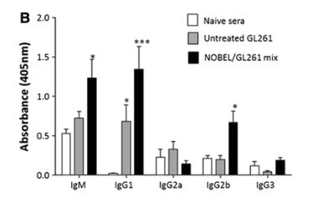
NOBEL antisense in mice
NOBEL is immunostimulatory by inducing the formation of GBM-specific antibodies
Notes:
The thought is that we can activate the host’s own immune response to attack the cells, can we find other antigens to target for future vaccines?

Slide 22
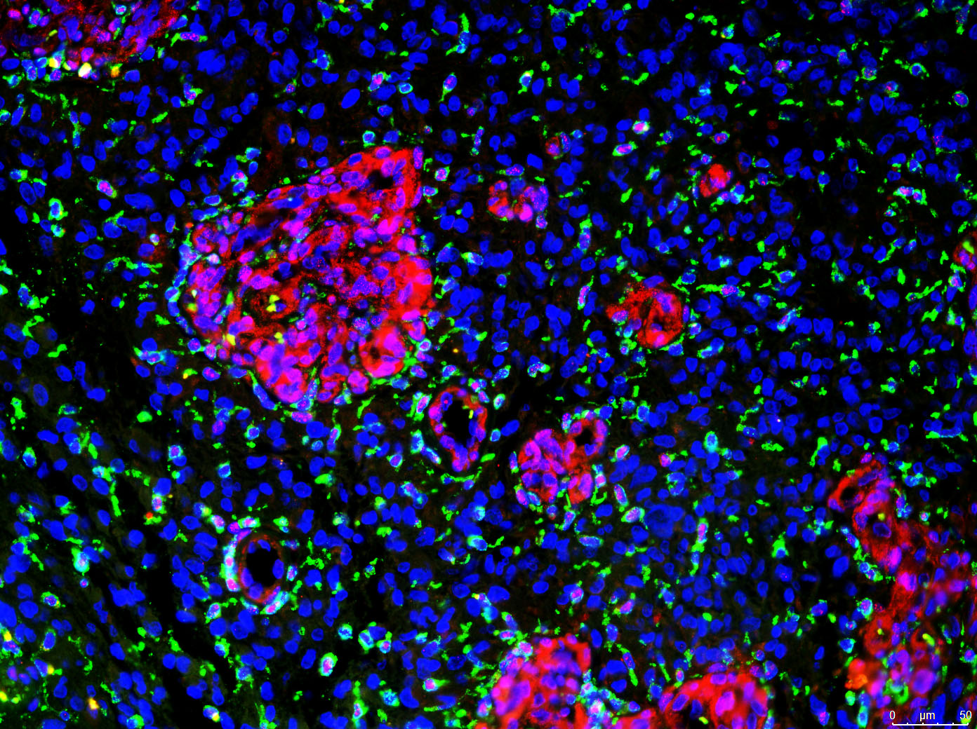
What about other targets?
The previous study focused on IGF-1R related to treatment
Red: MGMT
Green: CD163
Blue: DAPI

Slide 23
Tumor-associated macrophages
M1
Classically activated macrophages
In the tumor setting, they are pro-inflammatory and thought to dampen tumorigenicity
M2
Alternatively activated macrophages
Tend to act “anti-inflammatory” in the setting of cancer

Slide 24
MGMT: A double whammy?
Endothelial cells in the microvascular proliferation as well as some M2-type macrophages express MGMT
Interestingly, GBM has not responded as well to Bevacizumab (VEGF inhibitor) as might be expected given the amount of endothelial cell proliferation

Slide 25
New questions: Do the MGMT+ endothelial cells play a role in attracting the M2 macrophages to the areas of neovascularization? Do the MGMT+ vessels secrete some factor to alter expression of MGMT in the macrophages? Would MGMT be a suitable target for up and coming therapies?

Slide 26
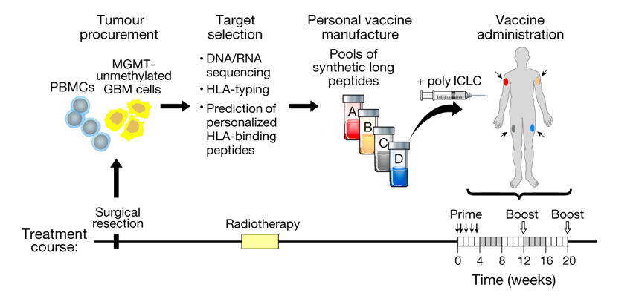
More exciting research about targeting the tumor immune response
Neoantigen vaccine generates intratumoral T cell responses in phase Ib glioblastoma trial
Keskin et al.
Notes:
Neoantigens can generate robust immune response that facilitates tumor rejection

Slide 27
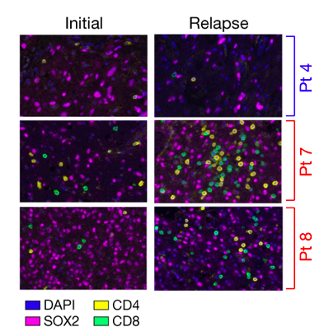
Patients not receiving dexamethasone demonstrated increased T cell infiltration

Slide 28
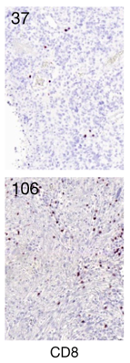
Another study in Nature…
Actively personalized vaccination trial for newly diagnosed glioblastoma
Hilf et al.
Phase I trial involving 15 patients with either HLA-A*02:01 or HLA-A*24:02
Demonstrated favorable safety, strong immunogenicity, and sustained responses of memory CD8+ T cells for the former and CD4+ T cells for the latter

Slide 29
What did we learn from these studies?
GBM does not respond well to checkpoint inhibitors because they require a high mutational load and multiple neoepitopes to be successful
HOWEVER!
Neoantigen vaccination is possible for immunologically “cold” tumors with low mutation rates
Systemic immune responses in the first trial were isolated to patients who did not receive an immune dampening agent suggesting an intact immune system is necessary for any type of vaccine-based therapy to work

Slide 30
What about other components of the tumor microenvironment?
While the immune response is a hot topic, there are other reasonable targets swimming about
These include factors in the extracellular matrix
Proteoglycans, growth factors, cell surface receptors

Slide 31
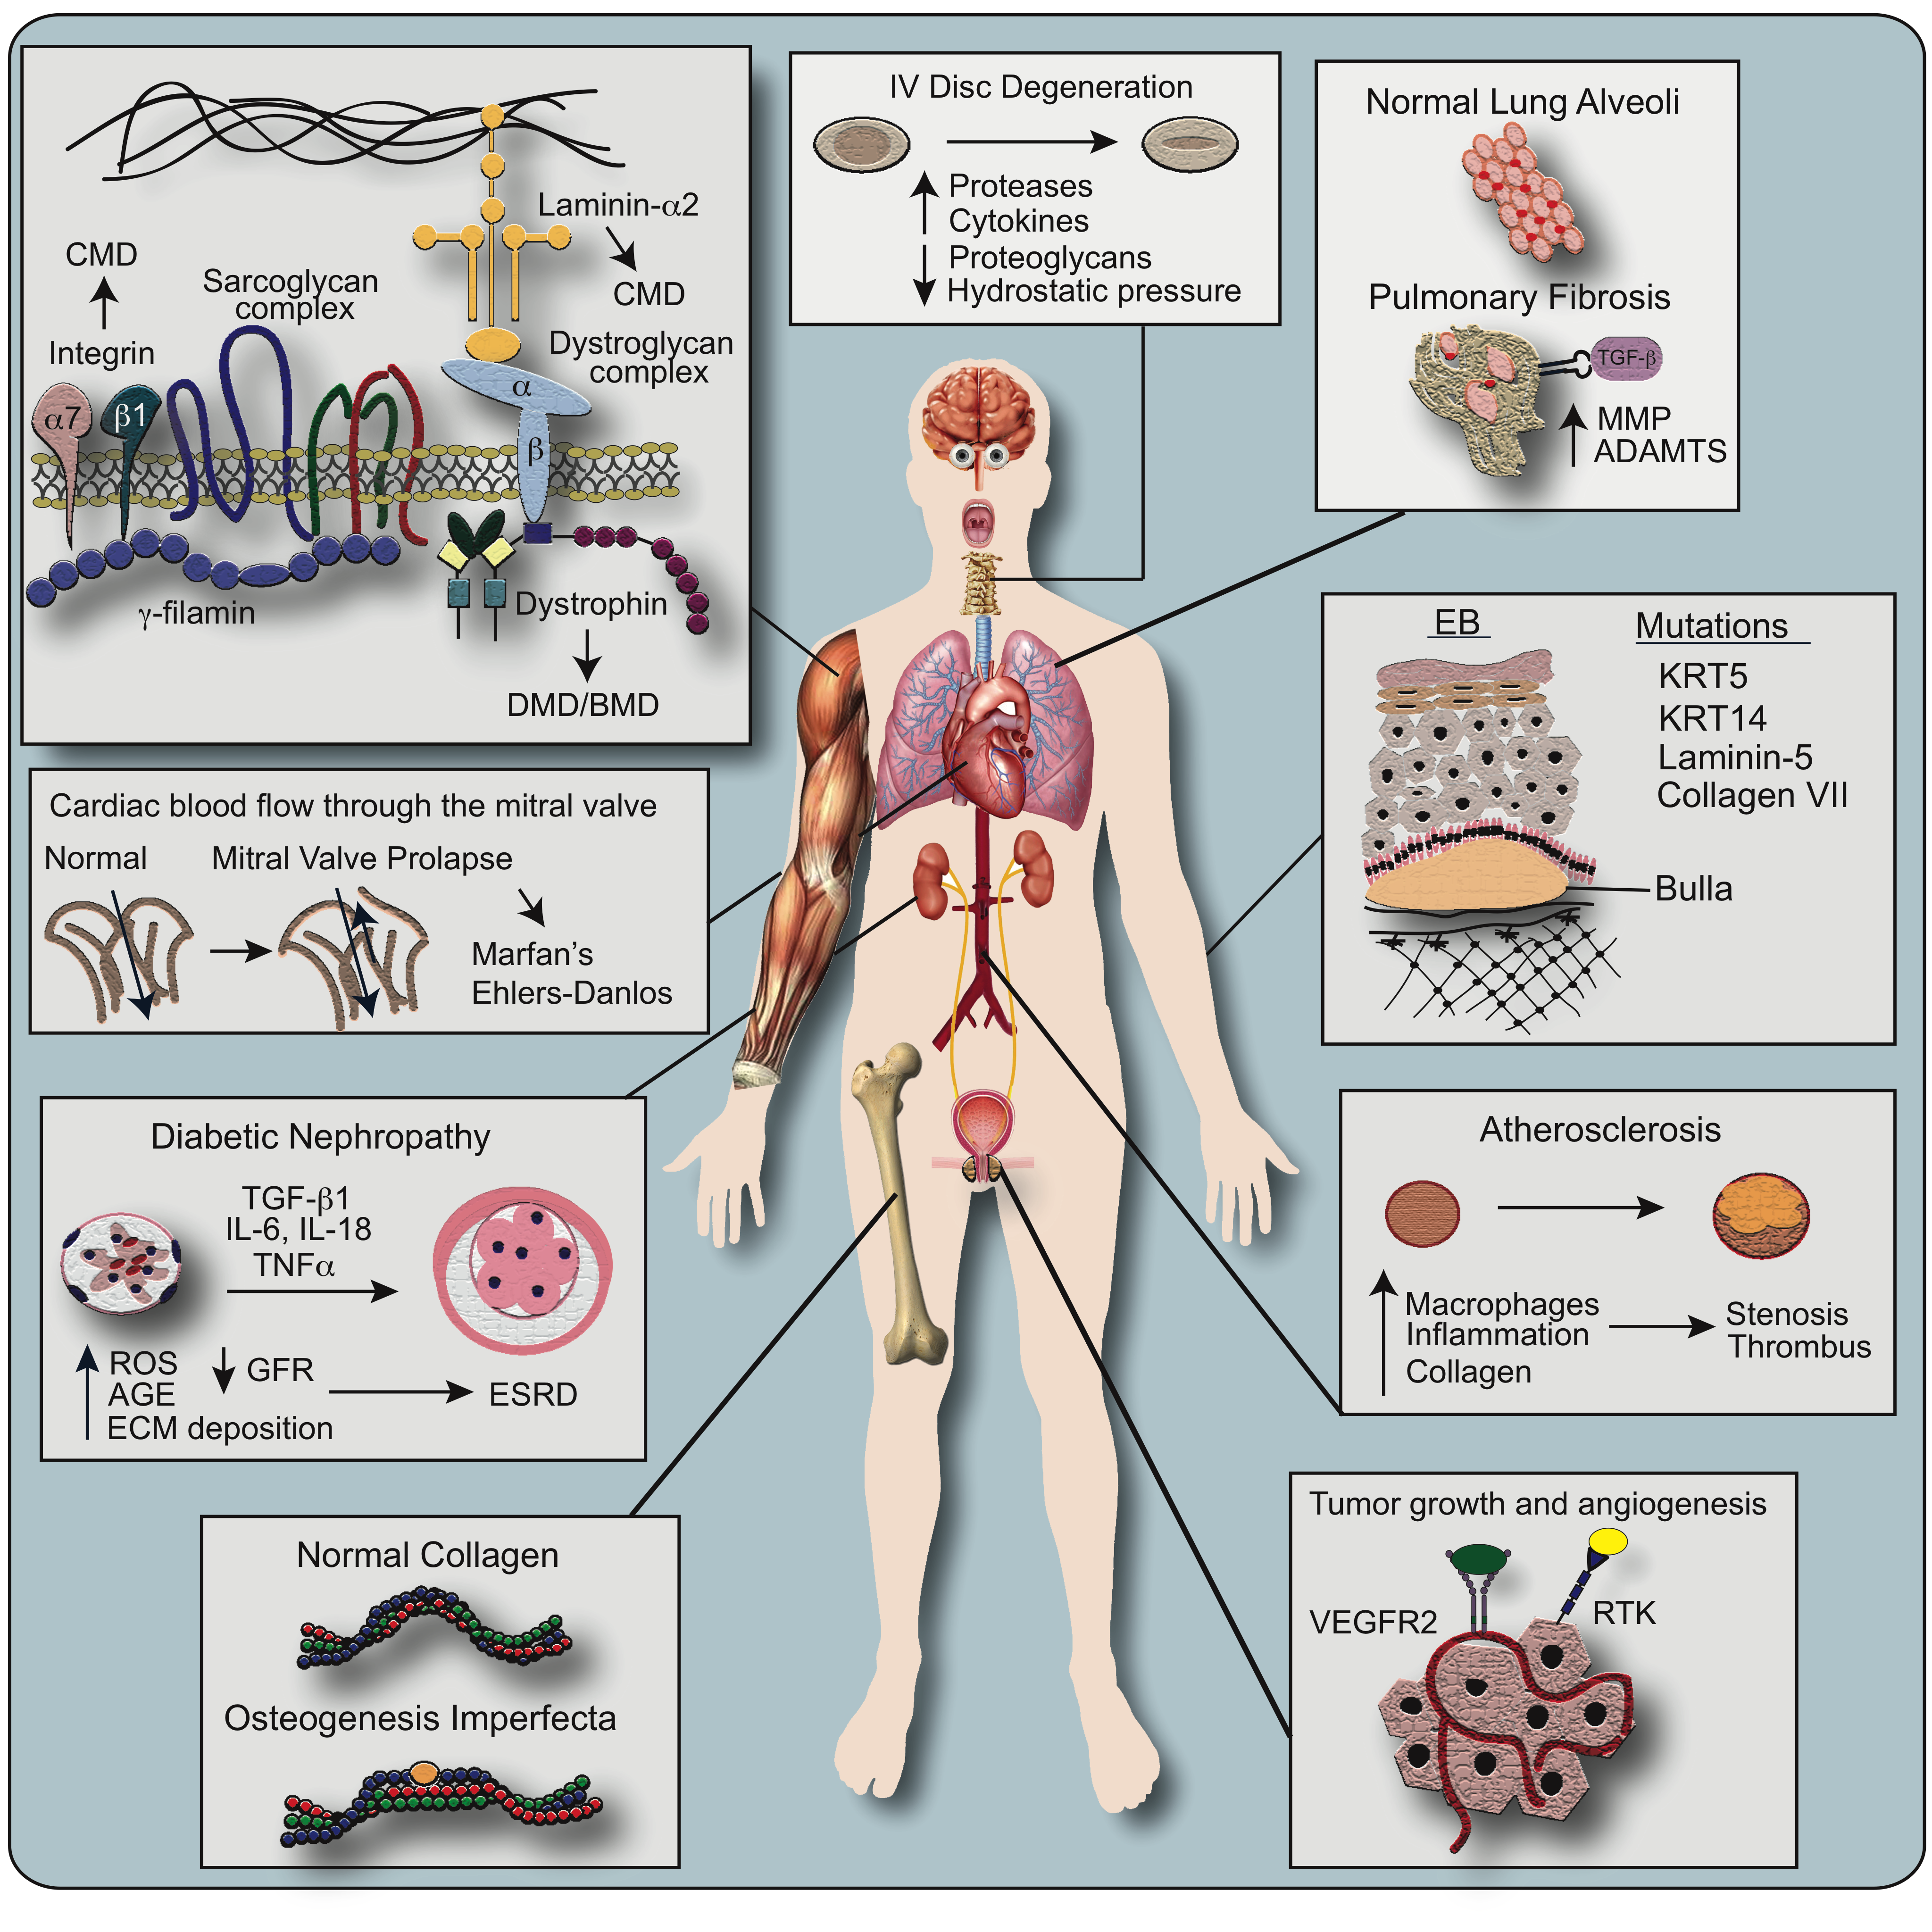

Slide 32
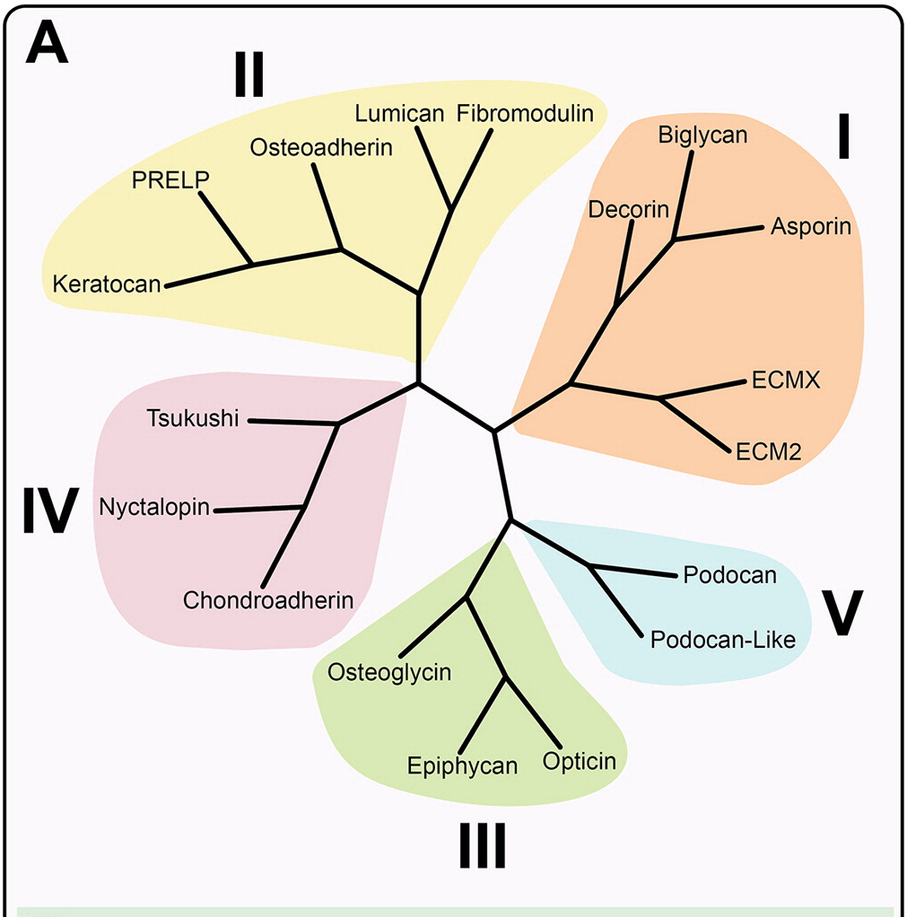
Proteoglycans: An Essential Component of the Matrix
Variety of functions ranging from immunity to metastasis
Several different families of proteoglycans in various locations including intracellular, basement membrane, and extracellular

Slide 33
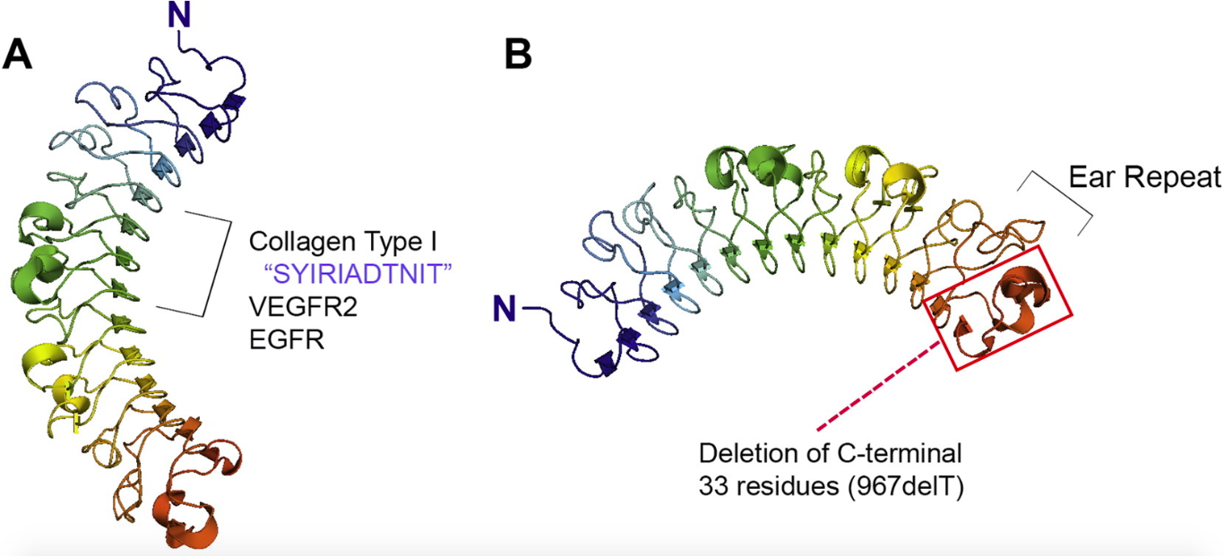
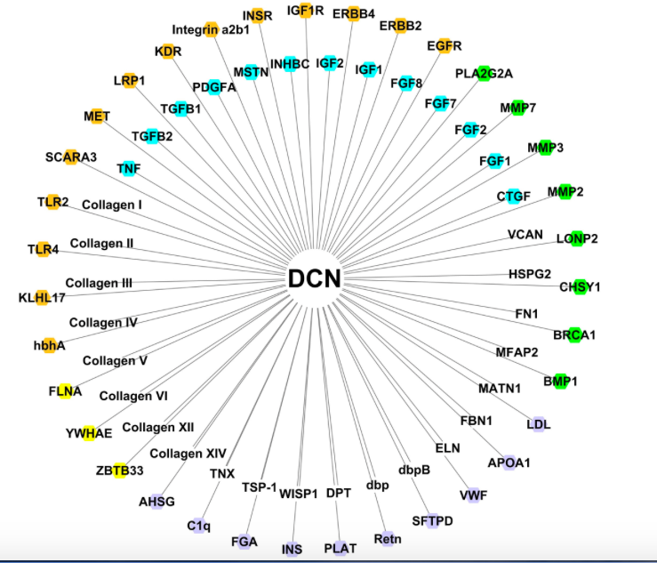
Decorin: A Versatile Small, Leucine-rich Proteoglycan

Slide 34
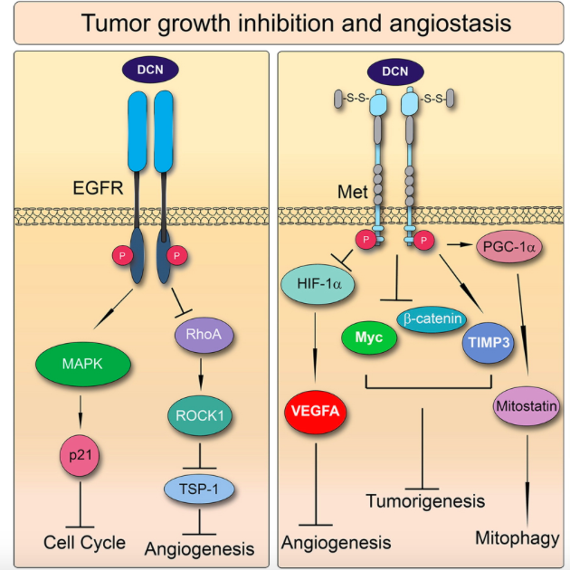

Slide 35
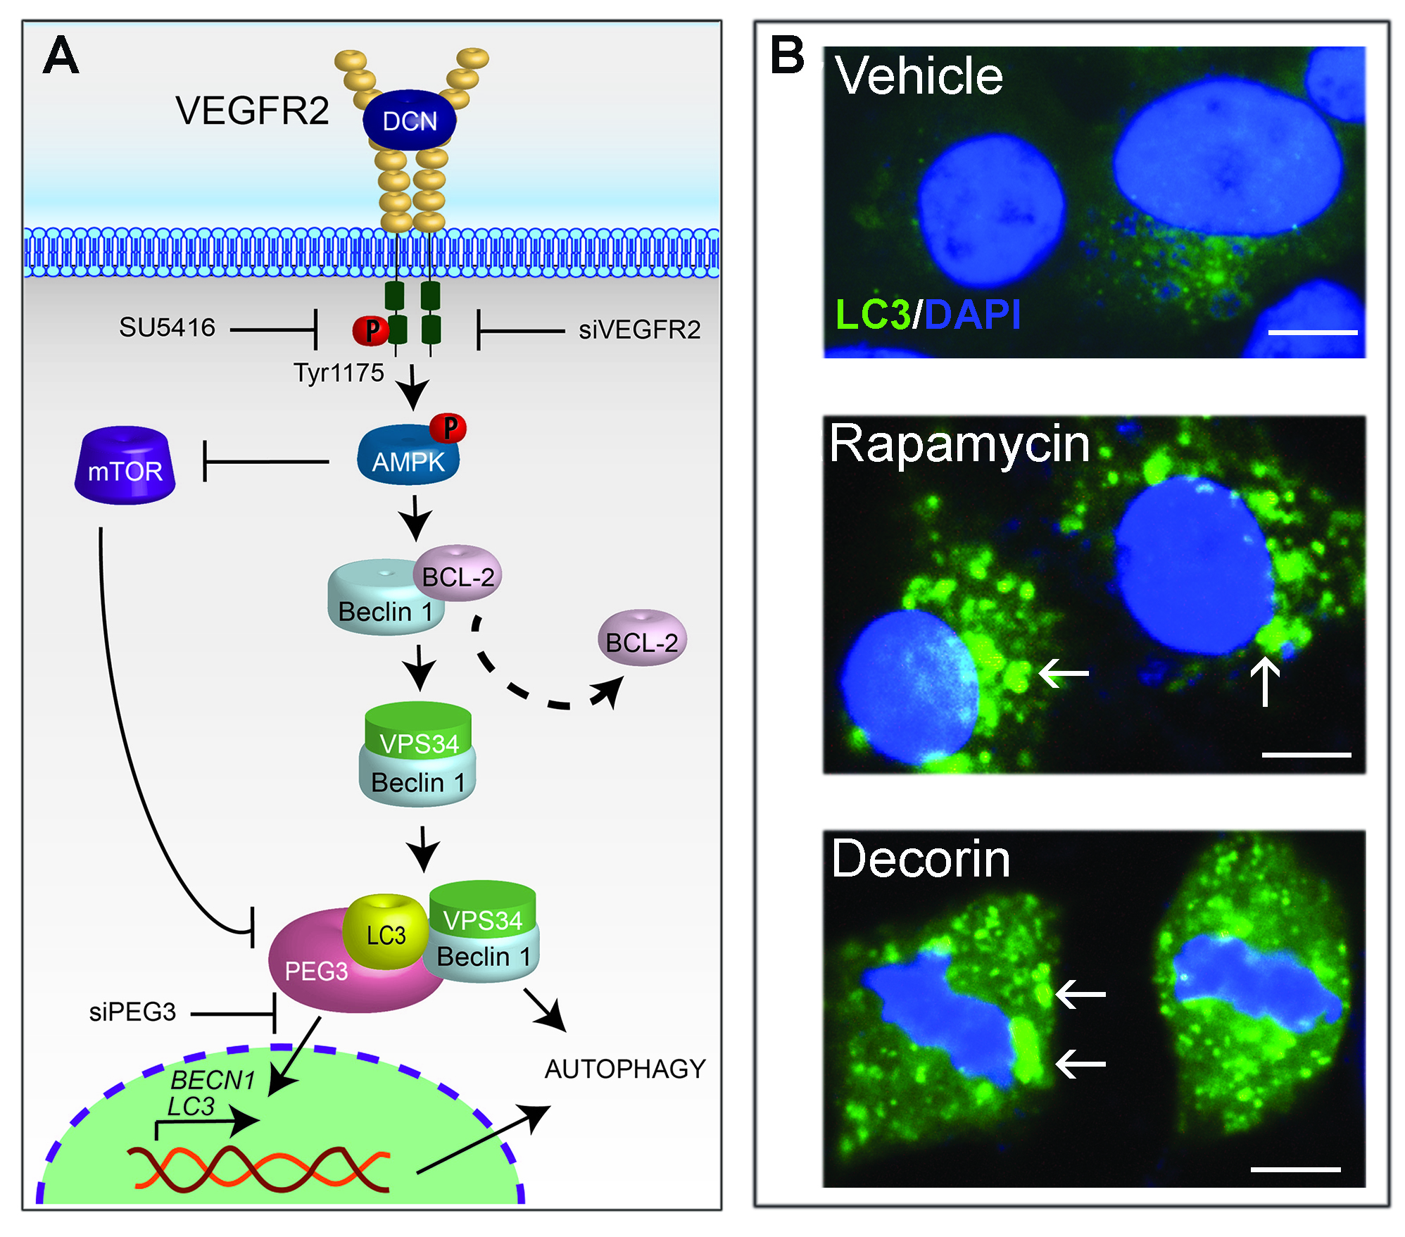

Slide 36
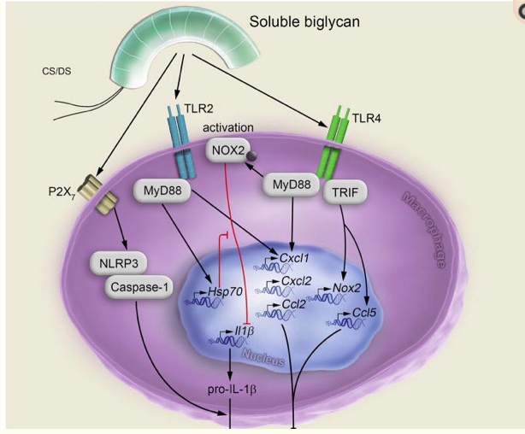
Biglycan, another SLRP that is directly involved in regulating the immune response

Slide 37
Can decorin or its relatives be involved in GBM?
Seems plausible…
Future directions:
Matrisome study of either pediatric or adult glial neoplasms and assess extracellular matrix components as a whole
Single-cell sequencing and study specific cell populations and the correlation between these cells and prognostic/diagnostic/therapeutic markers
Hunt for autophagy-related drug targets

Slide 38
Thank you
SKMC at TJU
Dr. David Andrews, Dr. Craig Hooper, Dr. Lawrence Kenyon
Dr. Renato Iozzo
All of you!

Slide 39
Any Questions?

Slide 40
References
Nature. 2019 Jan;565(7738):234-239. doi: 10.1038/s41586-018-0792-9. Epub 2018 Dec 19.
Neoantigen vaccine generates intratumoral T cell responses in phase Ib glioblastoma trial.
Keskin DB1,2,3,4,5, Anandappa AJ1,4, Sun J1, Tirosh I3,6, Mathewson ND4,7, Li S3,5, Oliveira G1, Giobbie-Hurder A8, Felt K9, Gjini E9, Shukla SA1,5, Hu Z1, Li L1, Le PM1, Allesøe RL1,10, Richman AR3,4,11,12, Kowalczyk MS3, Abdelrahman S9, Geduldig JE13, Charbonneau S13, Pelton K13, Iorgulescu JB1,4,14, Elagina L3, Zhang W1, Olive O1, McCluskey C1, Olsen LR10, Stevens J14, Lane WJ4,14, Salazar AM15, Daley H1, Wen PY1,4,16, Chiocca EA4,17, Harden M3, Lennon NJ3, Gabriel S3, Getz G3,4,12, Lander ES3, Regev A3, Ritz J1,2,4, Neuberg D8, Rodig SJ4,9,14, Ligon KL3,4,13,14, Suvà ML3,4,11,12, Wucherpfennig KW4,7, Hacohen N3,4,12, Fritsch EF1,3,18, Livak KJ1,5, Ott PA1,2,4, Wu CJ1,2,3,4, Reardon DA19,20,21.
Nature. 2019 Jan;565(7738):240-245. doi: 10.1038/s41586-018-0810-y. Epub 2018 Dec 19.
Actively personalized vaccination trial for newly diagnosed glioblastoma.
Hilf N1, Kuttruff-Coqui S1, Frenzel K2, Bukur V2, Stevanović S3,4, Gouttefangeas C3,4,5, Platten M6,7,8, Tabatabai G3,4,9, Dutoit V10, van der Burg SH5,11, Thor Straten P5,12,13, Martínez-Ricarte F14, Ponsati B15, Okada H16,17, Lassen U18, Admon A19, Ottensmeier CH20, Ulges A1, Kreiter S2,5, von Deimling A6,7, Skardelly M9, Migliorini D10, Kroep JR11, Idorn M12,13, Rodon J14,21, Piró J15, Poulsen HS18, Shraibman B19, McCann K20, Mendrzyk R1, Löwer M2, Stieglbauer M3,5, Britten CM2,5,22, Capper D6,7,23, Welters MJP5,11, Sahuquillo J14, Kiesel K1, Derhovanessian E2, Rusch E3,5, Bunse L6,7, Song C1, Heesch S2, Wagner C1, Kemmer-Brück A2, Ludwig J1, Castle JC2,24, Schoor O1, Tadmor AD25, Green E7,8, Fritsche J1, Meyer M1, Pawlowski N1, Dorner S1, Hoffgaard F1, Rössler B1, Maurer D1, Weinschenk T1, Reinhardt C1, Huber C2, Rammensee HG3,4, Singh-Jasuja H1, Sahin U2, Dietrich PY10, Wick W26,27.

Slide 41
References
Cancer Immunol Immunother. 2015 Apr;64(4):447-57. doi: 10.1007/s00262-015-1654-z. Epub 2015 Jan 13.
Enhancement of glioma-specific immunity in mice by "NOBEL", an insulin-like growth factor 1 receptor antisense oligodeoxynucleotide.
Morin-Brureau M1, Hooper KM, Prosniak M, Sauma S, Harshyne LA, Andrews DW, Hooper DC.
Matrix Biol. 2018 Oct;71-72:1-9. doi: 10.1016/j.matbio.2018.03.023. Epub 2018 Apr 3.
Extracellular matrix: The driving force of mammalian diseases.
Iozzo RV1, Gubbiotti MA2.
FEBS J. 2017 Jan;284(1):10-26. doi: 10.1111/febs.13963. Epub 2016 Dec 7.
Proteoglycan neofunctions: regulation of inflammation and autophagy in cancer biology.
Schaefer L1, Tredup C1, Gubbiotti MA2, Iozzo RV2.
The 2016 World Health Organization Classi cation of Tumors of the Central Nervous System: a summary
David N. Louis1 · Arie Perry2 · Guido Reifenberger3,4 · Andreas von Deimling4,5 · Dominique Figarella‐Branger6 · Webster K. Cavenee7 · Hiroko Ohgaki8 · Otmar D. Wiestler9 · Paul Kleihues10 · David W. Ellison11

